Slide 1

Cryo-Images Project
Adil Al-Azzawi

Slide 2
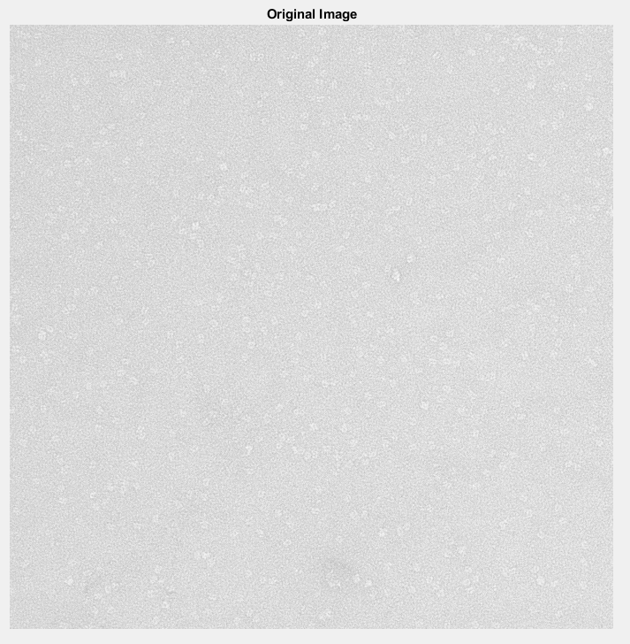
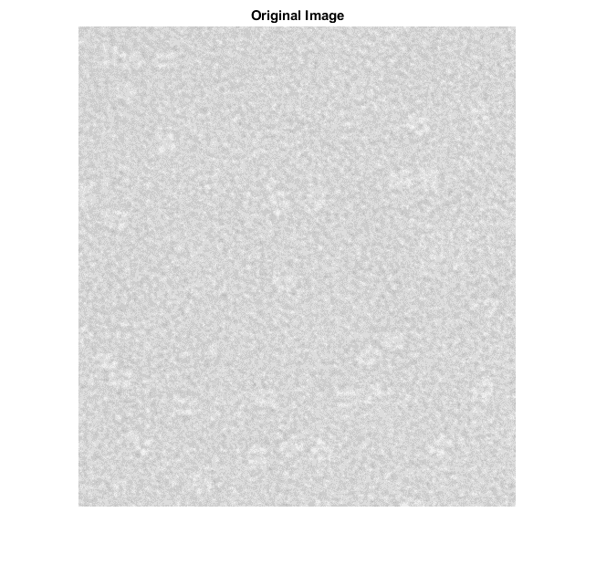
CryoEM image
Adil Al-Azzawi

Slide 3
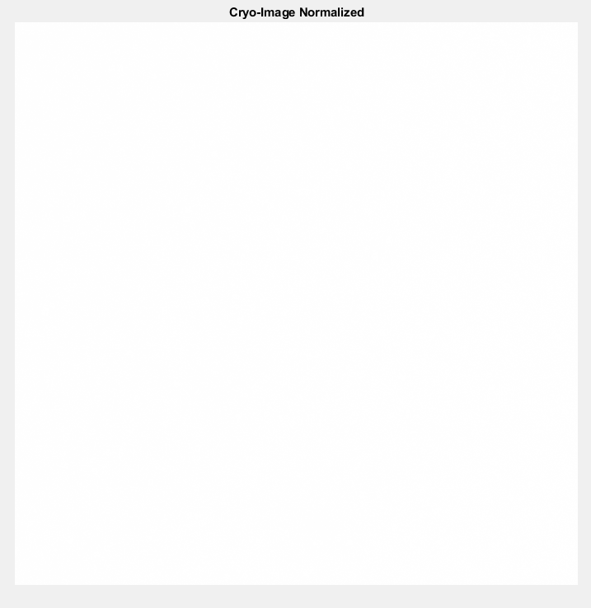
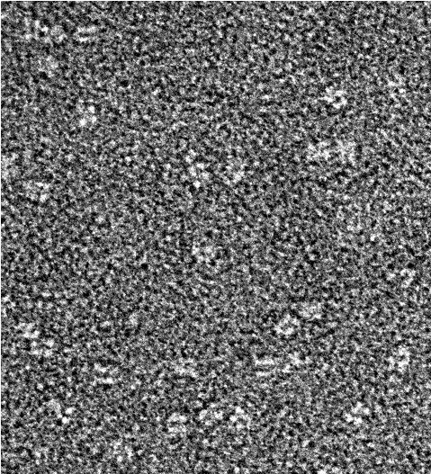
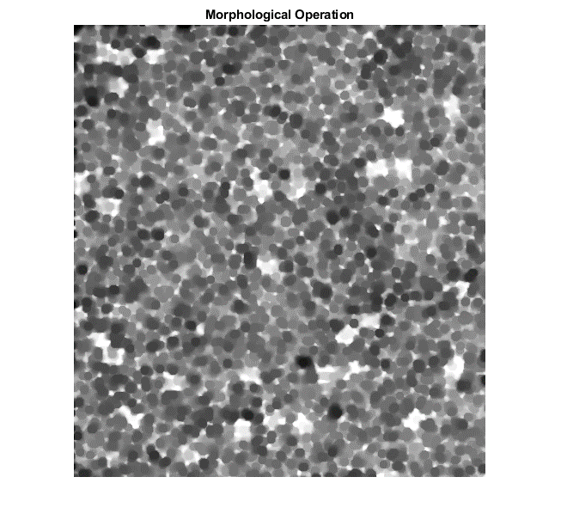
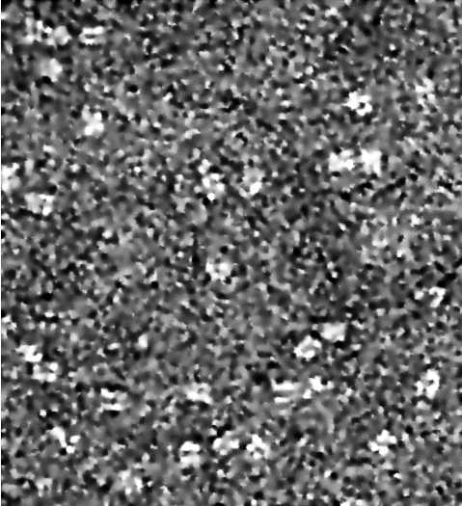
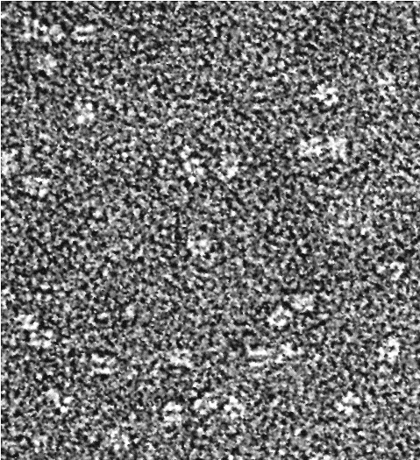

Pre-processing
CryoEM Image
Image Normalization
Contrast Transfer Function (CTF)
Image Adjustment
Morphological Image Operation
Image Guided Filtering
Adaptive Histo-Equal.
Hist-Equalization
Adil Al-Azzawi

Slide 4
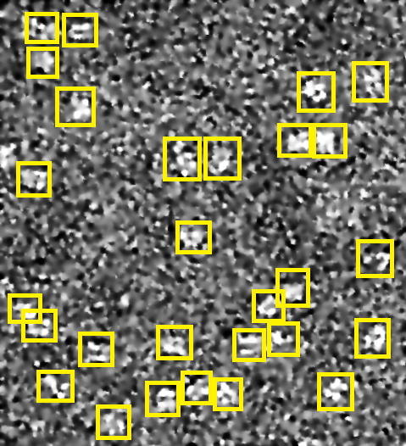
CryoEM image
Hand Labeled
Adil Al-Azzawi

Slide 5
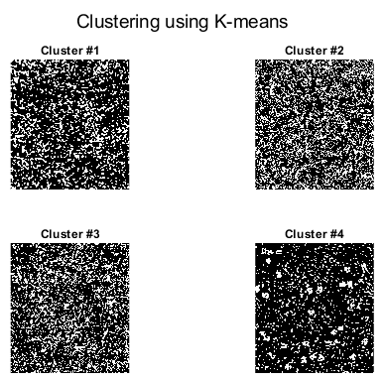
CryoEM image
Adil Al-Azzawi

Slide 6
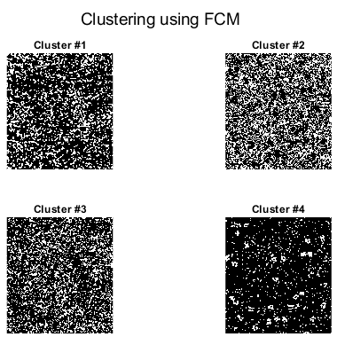
CryoEM image
Adil Al-Azzawi

Slide 7
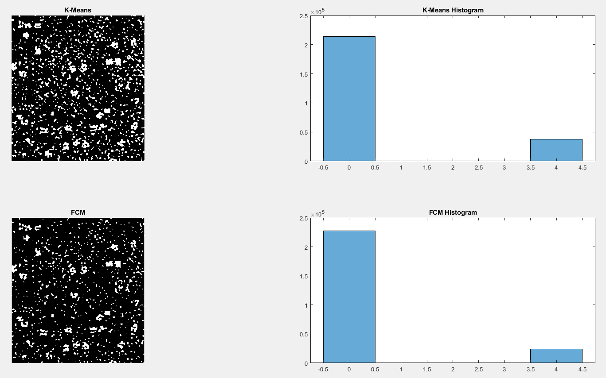
CryoEM image
Background
Objects
Background
Objects
Adil Al-Azzawi

Slide 8
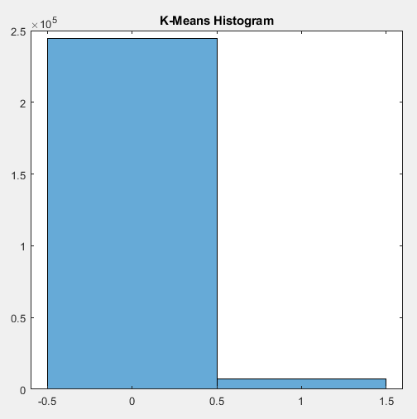
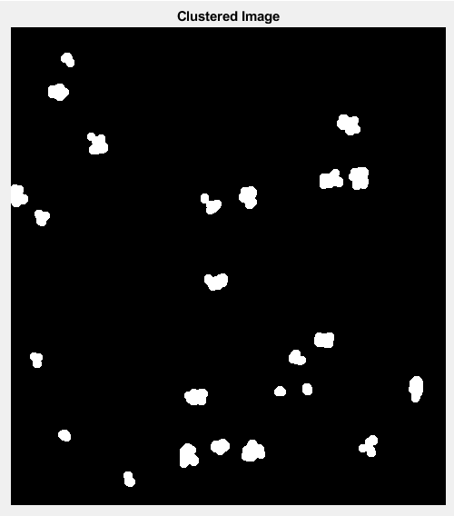
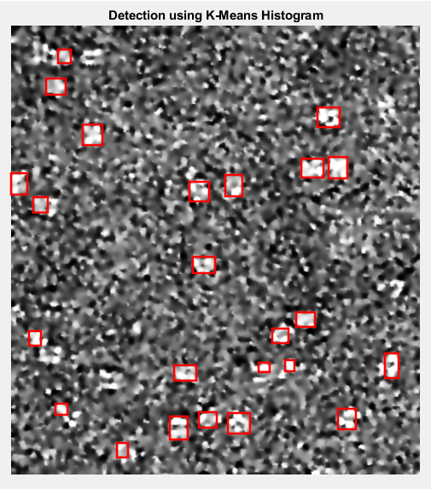
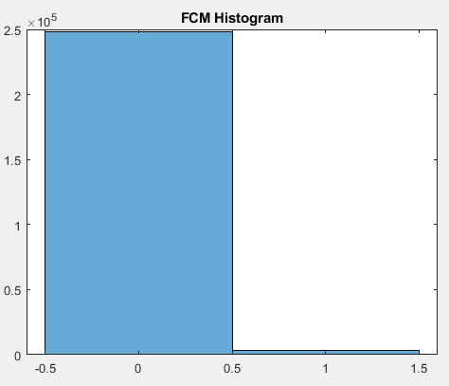
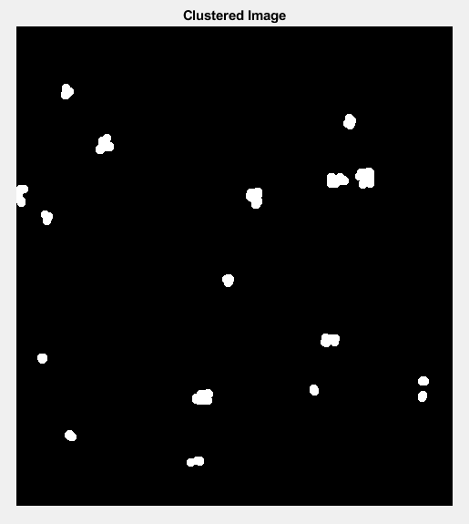
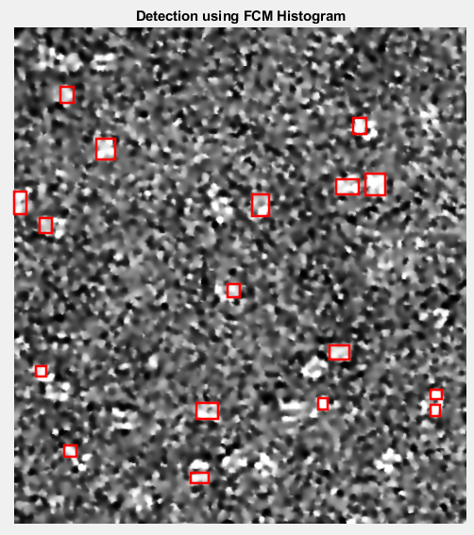
CryoEM image
Background
Objects
Background
Objects
Adil Al-Azzawi

Slide 9
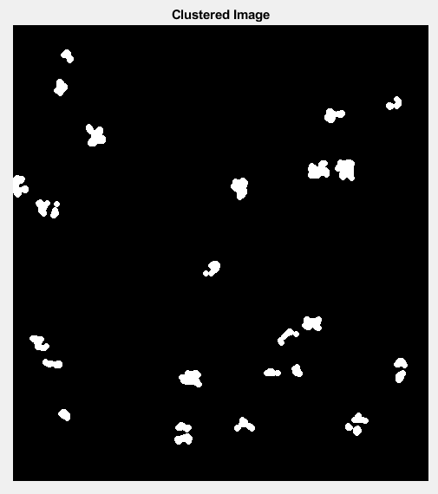
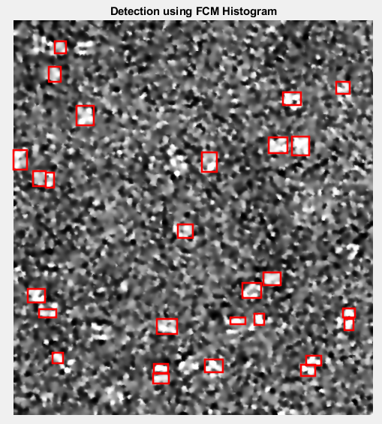
CryoEM image
24 Particles
28 Particles
27 Particles
28 Particles
Adil Al-Azzawi

